Slide 1
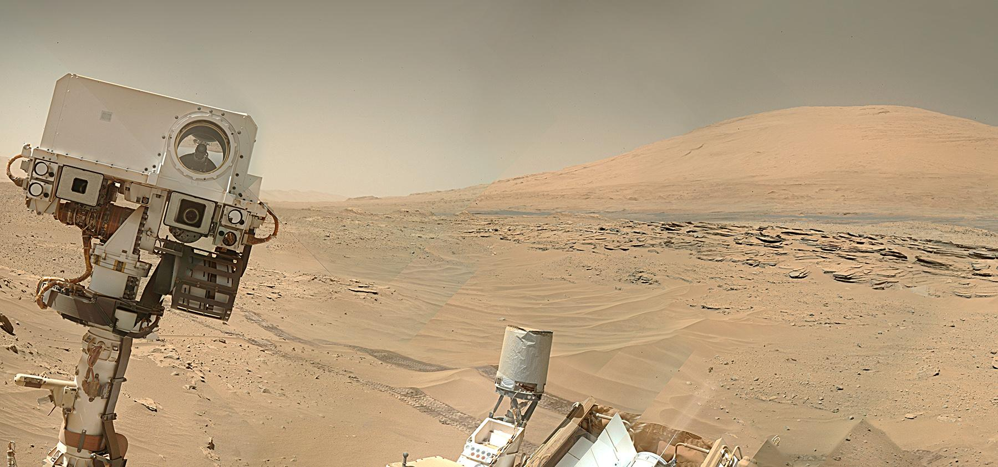
Understanding Martian Subsurface Geochemistry using the Dynamic Albedo of Neutrons Instrument on the Mars Science Laboratory Curiosity Rover
Jack Lightholder
Mentor: Dr. Craig Hardgrove

Slide 2
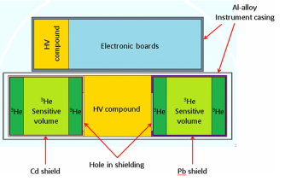
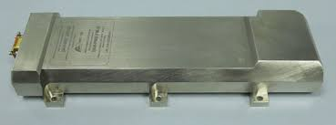
Dynamic Albedo of Neutrons (DAN) Instrument
Monitor backscatter time of neutrons to inform subsurface Martian geochemistry.
Pulse Neutron Generator (PNG)
Output will decay over mission duration
He³ Detector tubes
Cadmium coated (thermal neutron detection)
Lead coated (epithermal neutron detection)

Slide 3
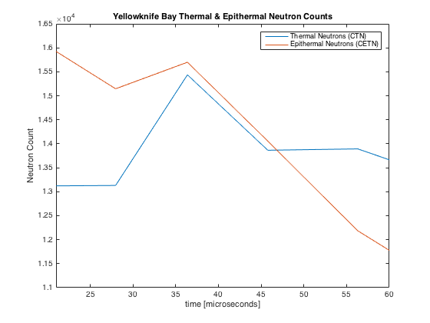
Experimental Results
Thermal and Epithermal neutron counts over time.
Snapshot of a local geochemistry.
Requires adjustment with respect to PNG decay.
Neutrons from the PNG arriving at the detector after backscattering off local environment.
Rover structure
Soil target

Slide 4
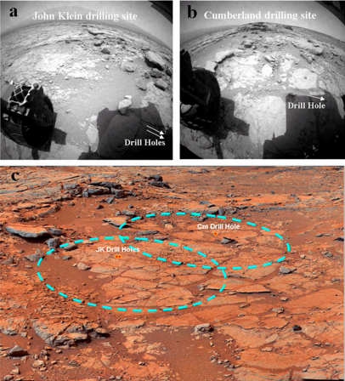
MCNPX Monte Carlo Simulations
Monte Carlo sampling to determine statistical convergence.
10⁶ simulations for neutron convergence
Inputs attempt to match Martian conditions
Vary similarity between theoretical subsurface material layer layers
Vary depth of each layer
Vary composition of each layer
APXS data
Drill site data
Develop modeling grids for running bulk simulations, testing varied permutations of potential inputs

Slide 5
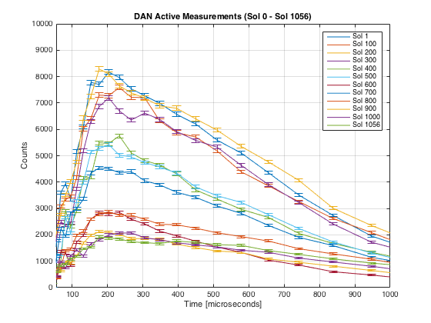
Characterising PNG Decay Impact
Impacts statistical correlation to simulation data.
Important for future experiment decisions.
Locations
Experiment duration
Provides insight into remaining instrument life.
Non-linear decay

Slide 6
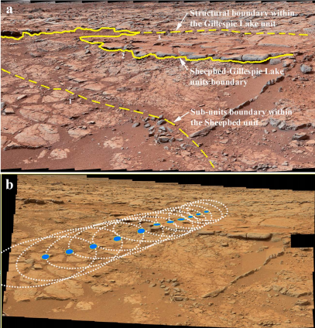
Data Correlation
Two sample 𝝌² statistical correlation.
Adjust DAN data for PNG decay
Adjust Monte Carlo simulation for geochemistry
Determine goodness of fit between a single DAN data set and all simulations in the modeling grid.
Utilize multiple DAN experiment locations to reduce free variables and accurately correlate cause and effect relationships.

Slide 7
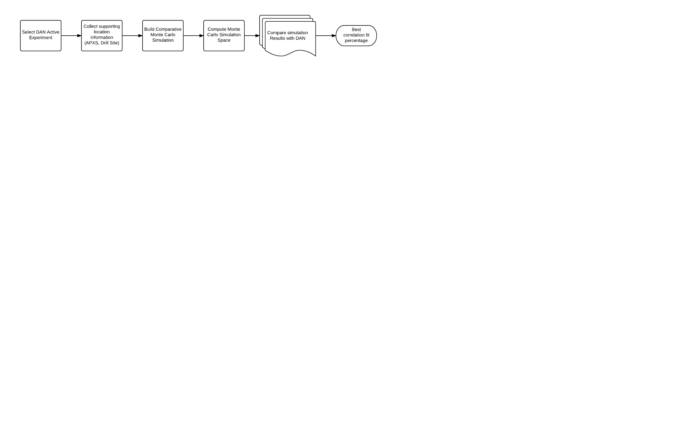
Analysis Pipeline Development
Develop automated processes for correlating DAN experiments with APXS drill site information.
Develop automated processes for parsing Planetary Data System (PDS) data and generating usable DAN experiment data.
Develop statistical tests for correlating DAN data with Monte Carlo simulation results.
Develop analysis tools for visualizing and representing DAN data for individual experiments and cumulative statistics over mission lifetime.

Slide 8
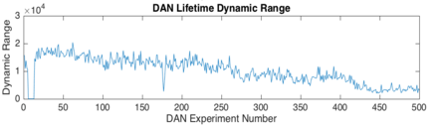
Conclusions
Rover structure backscatter has a notable impact on neutron detector curves.
PNG decay is significantly contributing to experimental results and must be considered on a measurement-by-measurement basis
Detector decay may be occurring, unevenly, contributing to additional statistical uncertainty.

Slide 9
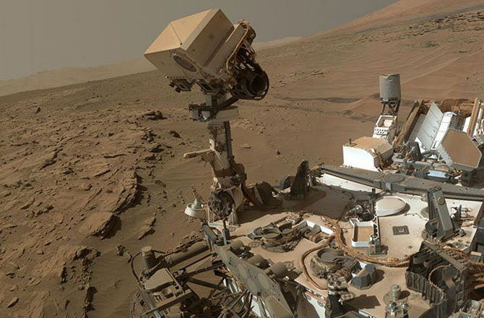
Questions?

